Slide 1
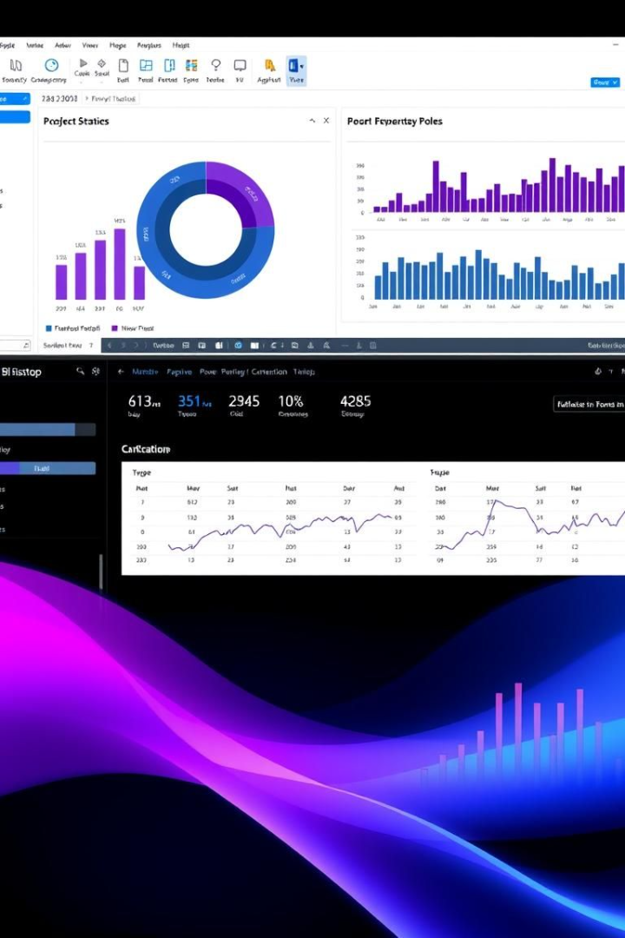
HR ANALYTICS DASHBOARD
Explore data visualization with Power BI Desktop.
Create interactive reports and dashboards.
Made by Karan Singh

Slide 2
Data Connectivity
Connect to Various Sources
Import and Transform Data
Power BI Desktop connects to databases and cloud services.
Shape data with Power Query Editor.

Slide 3
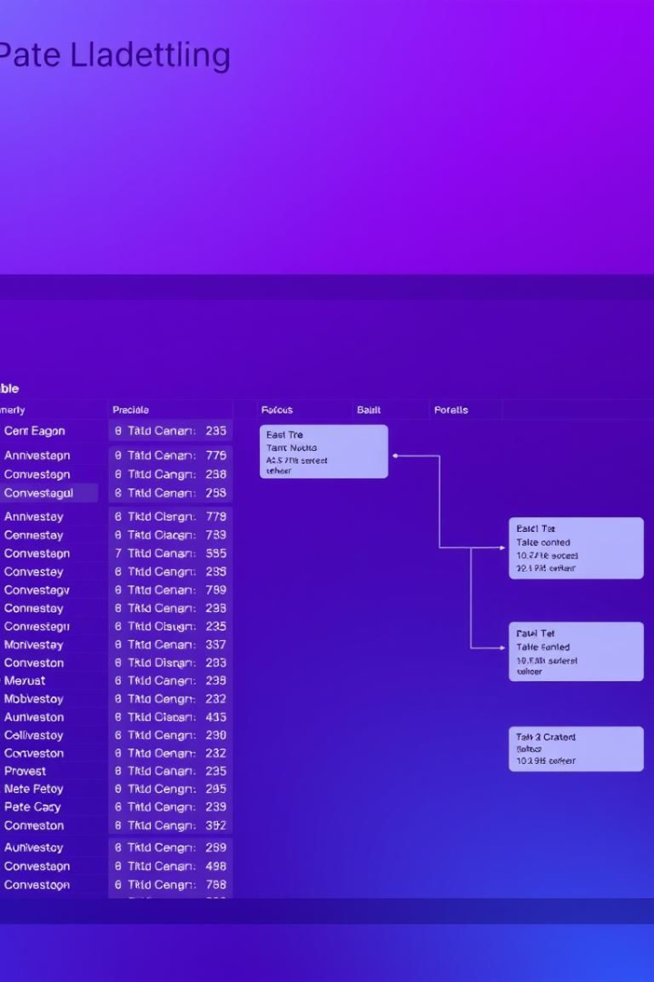
Data Modeling
Relationships
Calculated Columns
Define relationships between tables.
Create new columns using DAX.
Measures
Write DAX formulas for aggregations.

Slide 4
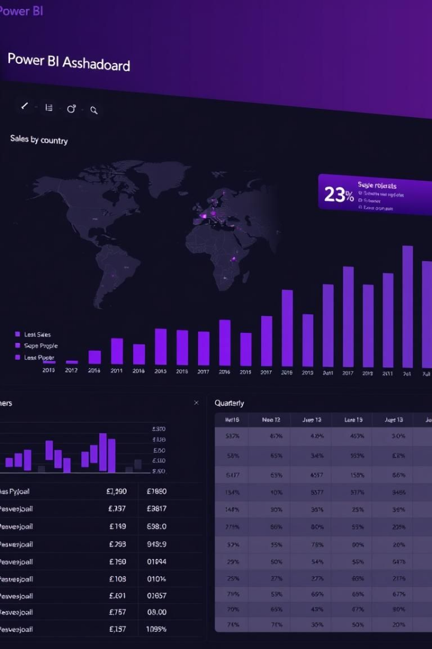



Visualizations
Charts
Maps
Tables

Slide 5
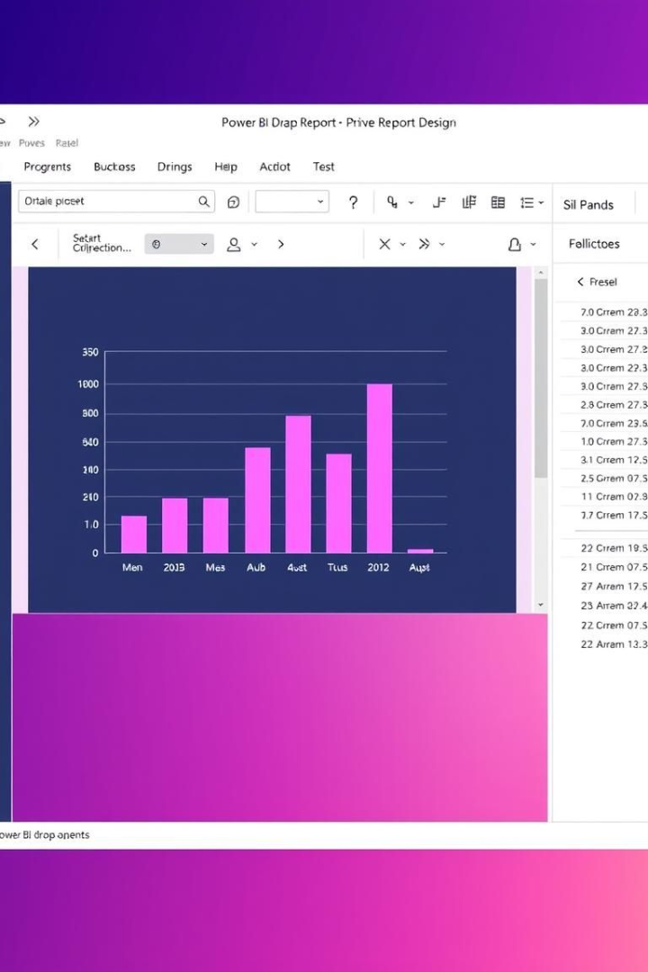



Report Design
Drag and Drop
Add visuals to the canvas.
Format
Customize appearance.
Interact
Add filters and slicers.

Slide 6
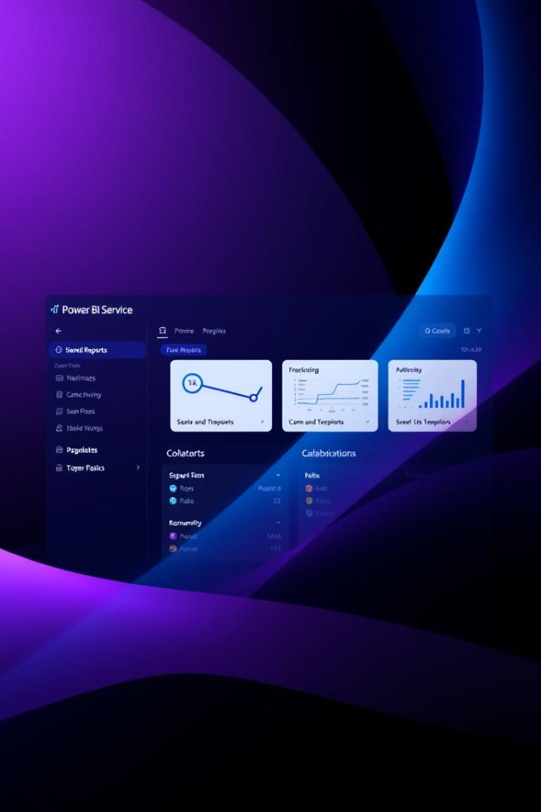
Power BI Service
1
Publish
Share reports online.
2
Collaborate
Work with colleagues.
3
Schedule
Refresh data automatically.

Slide 7
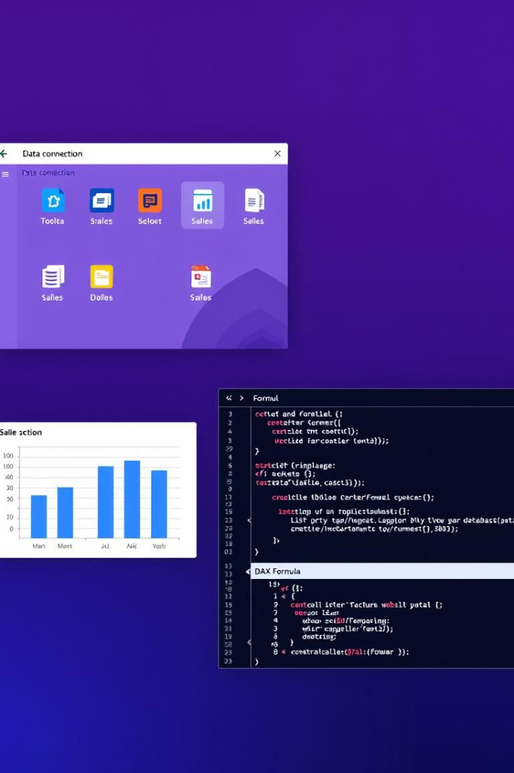
Key Features
Data Connectivity
Interactive Visuals
Connect to various data sources.
Create engaging reports.
DAX Calculations
Perform complex analysis.

Slide 8
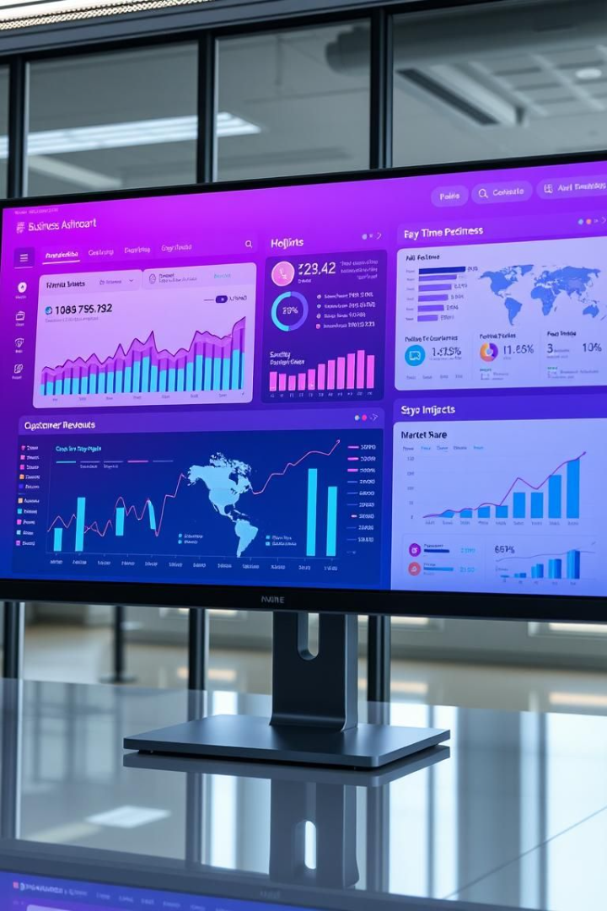
Benefits
50%
30%
Faster insights
Reduced costs
20%
Improved decisions

Slide 9
Employee KPI Overview
500
15%
Employee Count
Attrition Rate
Total workforce size
Percentage of employees leaving
35
$75K
Average Age
Average Salary
Typical employee age
Mean employee compensation

Slide 10
Attrition by Education
1
Education Field
2
Education Level
3
Insights
Attrition varies based on education field.
Each education level shows different attrition rates.
Use this chart for targeted retention strategies.

Slide 11
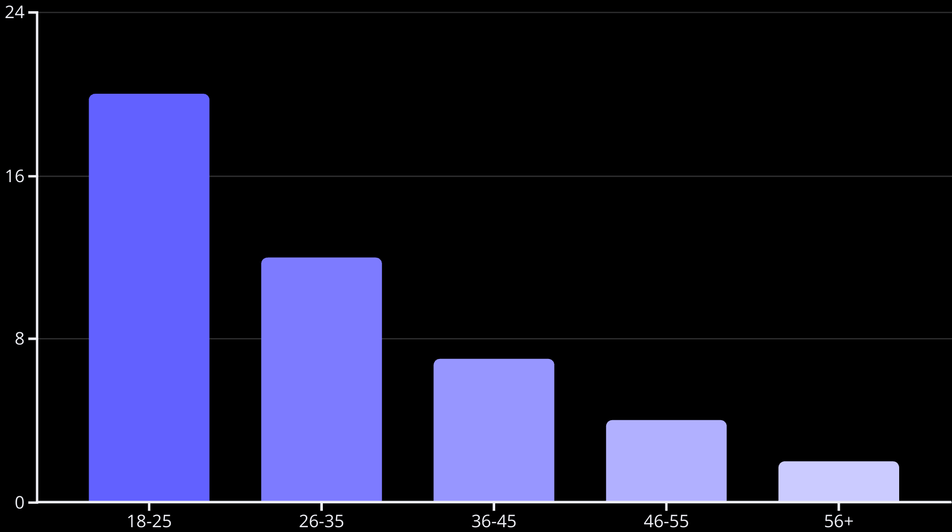
Attrition by Age Group
This bar graph shows attrition rates across different age groups. Younger employees (18-25) have the highest attrition rate. As age increases, the attrition rate decreases.

Slide 12
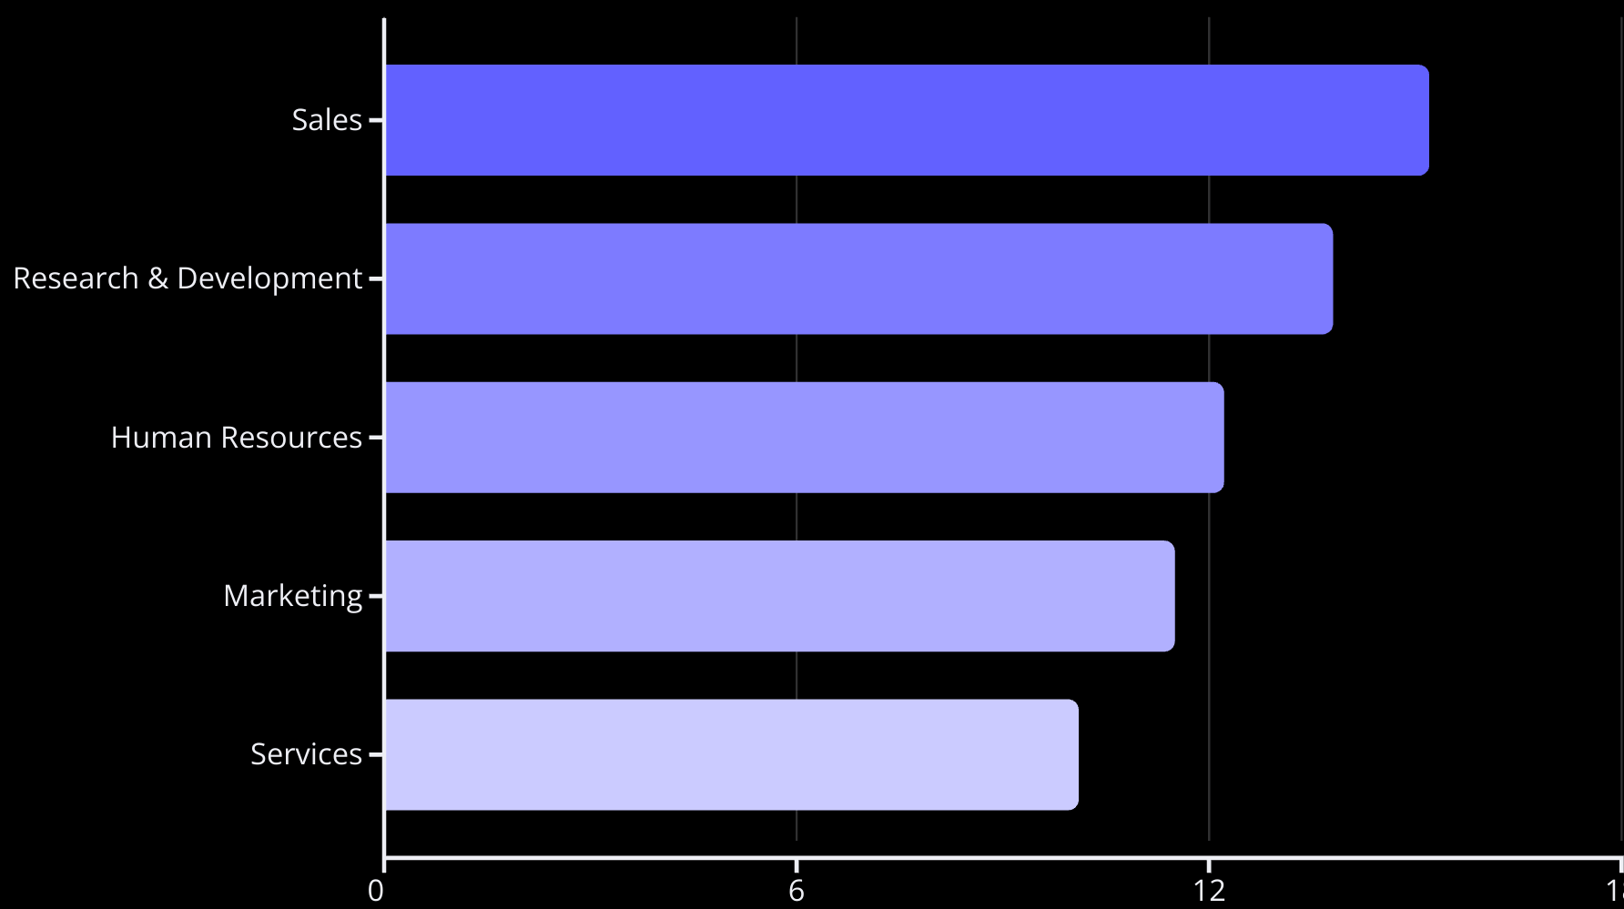
Attrition by Department
The horizontal bar chart shows attrition rates by department. Sales has the highest attrition rate at 15.2%. Human Resources has an attrition rate of 12.2%.

Slide 13
Attrition by Job Role
Sales Executive
Research Scientist
Other Roles
Sales Executives have high attrition rates. They often face high-pressure environments.
Research Scientists exhibit lower attrition. Their roles are often more stable and less stressful.
Other roles show varying attrition levels. Understanding nuances is critical.

Slide 15
Attrition by Tenure
Short Tenure
Mid Tenure
Long Tenure
Employees with short tenures show high attrition rates. This could be due to onboarding issues.
Attrition decreases during mid-level tenure. Employees may feel more stable in their positions.
Long-term employees exhibit low attrition rates. They're often more committed to the company.

Slide 16
Employee Count by Gender
Gender Breakdown
Insights
Visualize employee demographics with this report.
Reports help ensure equitable representation.
See the distribution of employees.
It addresses gender diversity goals.

Slide 17


Thank You
Thank you for your time and attention. We are happy to answer your questions.

